Slide 1
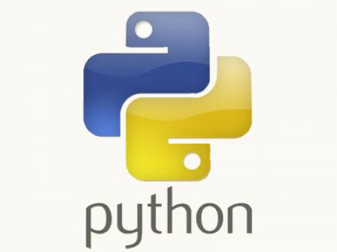
Python Training.....
-- Jeetendra Bhattad

Slide 2
Agenda
String
Data Structures
  List
  Tuple
  Set
  Dictionary

Slide 3
String
Its a sequence of characters
Single Quotes & Double Quotes are treated similar
Triple Quotes : doc-string, multiline comments
Strings are immutable
Representation & Slicing
Methods :-
  count
  index
  find
  join
  Isalnum, isalpha, isdigit, islower, isspace, isupper
  lstrip, rstrip, replace, partition, split, rsplit
  endswith, startswith

Slide 4
List
Ordered collections of heterogenous objects
Representation is similar to String
Mutable, can grow and shrink whenever required
Methods :-
  count
  append
  extend
  index
  insert, pop, remove, reverse, sort
  __add__, __contains__, __eq__, __ge__, __sizeof__ .....

Slide 5
Tuple
Ordered collections of heterogenous objects
Representation is similar to String, List
Immutable
Methods :-
  count
  index
  __mul__, __add__, __contains__, __eq__, __ge__, __sizeof__ .....

Slide 6
Set
Ordered collections of heterogenous unique objects
Representation is similar to String, List but cannot be sliced or accessed using index
Mutable
Methods :-
  add
  pop
  clear
  copy
  discard v/s remove (raise KeyError)
  difference, intersection, union .....

Slide 7
Dictionary
Unordered collection of key-value pairs
Representation is similar to String, List but cannot be sliced or accessed using index.
Mutable
Methods :-
  copy
  fromkeys
  has_key
  items
  keys, values
  iteritems, iterkeys, itervalues
  pop, popitem
  viewitems, viewkeys, viewvalues

Slide 8
Slicing
Slicing : extracting specific set of data from the container.
Lists, Strings & Tuple support Slicing
Reverse Indexing
Write a program to accept string/list from user and print it in reverse order

Slide 9
To be Studied & Tried
bytearray
xrange
deque
defaultdict

